Slide 1
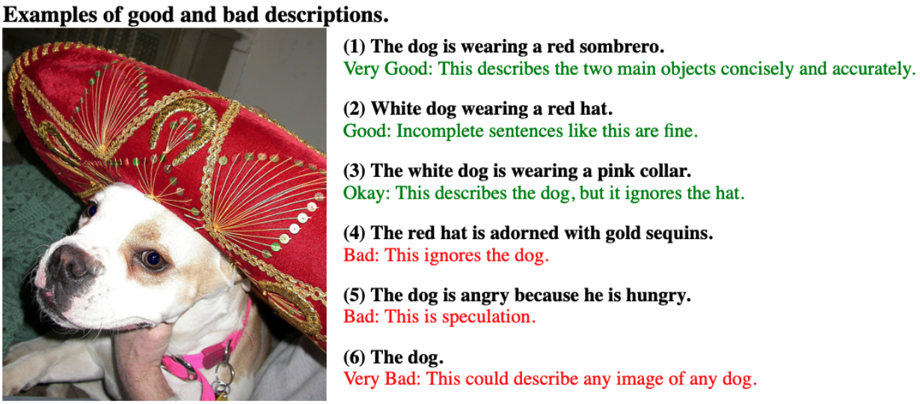
Image Description Guidelines
You must describe each of the following images with one sentence in your native language.
Please provide an accurate description of the activities, people, animals and objects you see depicted in the image.
Each description must be a single sentence under 100 characters. Write at least 8 words.
Make sure your caption is precise and specific about this image, and not general to describe similar ones.
Please pay attention to grammar and spelling.
We will accept your results if you provide a good description for all images.

Slide 2
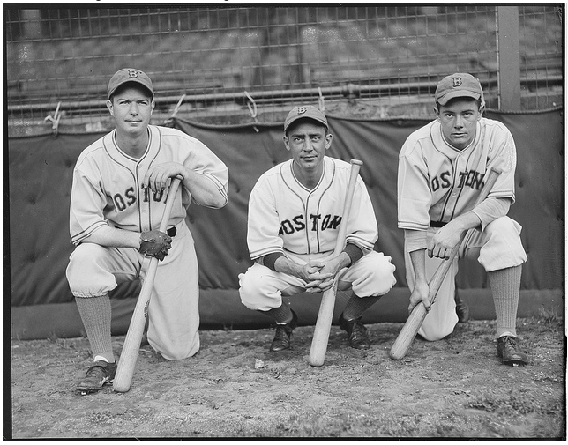
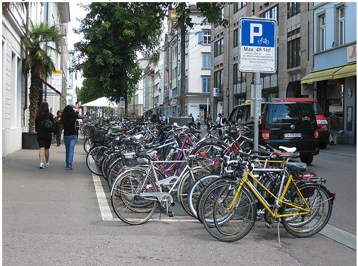
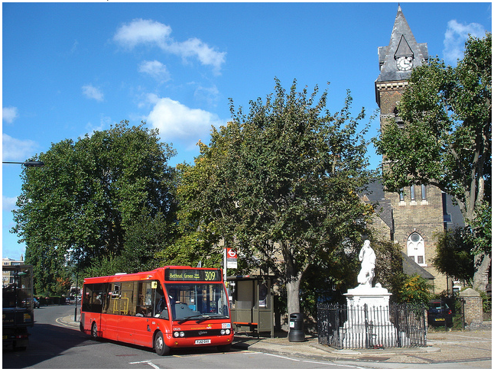
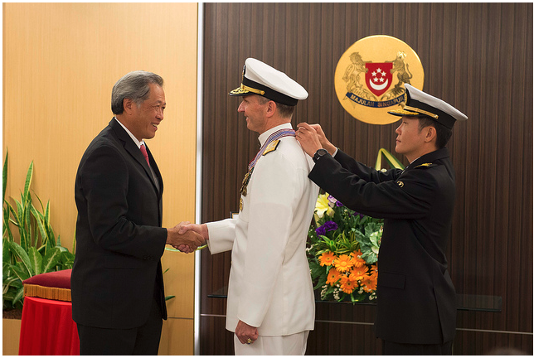
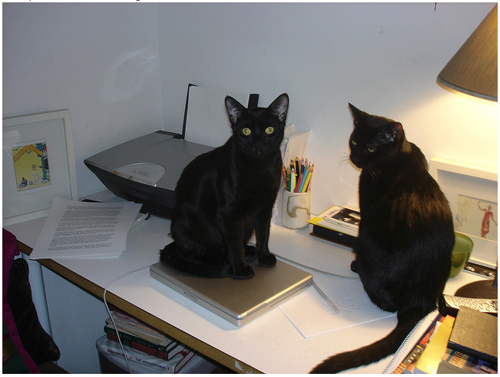
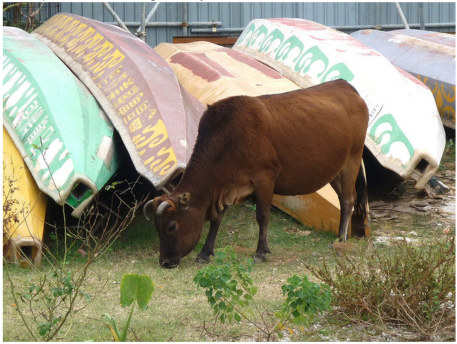
Examples in English
three redsox players are holding onto their bats while posing for a photo.
rows of bicycles on sidewalk next to cars and people.
an orange bus parked in front of a church with a tall clock tower.
two men shaking hands while a third person is putting a medal on one of them.
two black cats sitting on a desk with one on a laptop and one on papers.
a cow is grazing by a group of boats on the grass.

Slide 3
Write your Prolific ID

Slide 104
End of Study

